Slide 1
Java

Slide 2
Agenda
Internet Basics
Timeline of Internet
Java History
Java Features
Java Architecture

Slide 3

Lets Begin with Internet
2
Introduction

Slide 4
Introduction
internet was started in the year 1960 as a way for government research to share information
Initially, it was called as ARPANet (Advanced Research Projects Agency Network started by Defence Department in America
January 1st 1983 is considered as official birth of internet as a new communication protocol was established named as TCP/IP
Different kinds of network talk to each other in different ways.
2

Slide 5
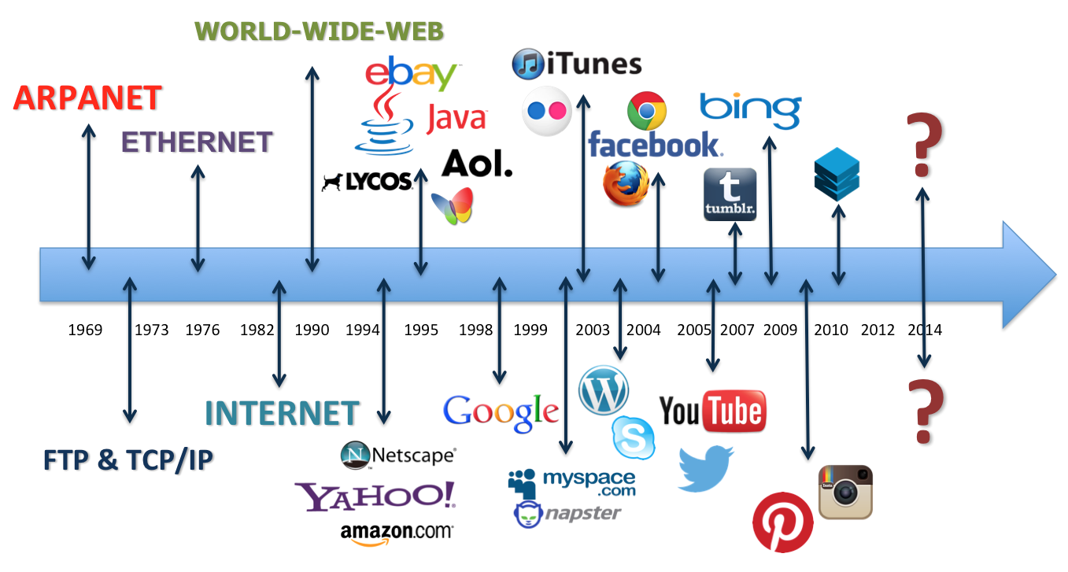
Introduction
2

Slide 6
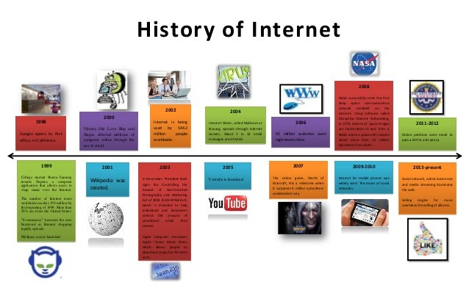
Introduction
2

Slide 7

Lets Begin With
Java

Slide 8
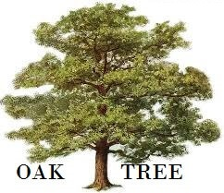

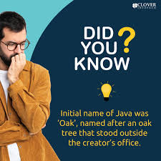
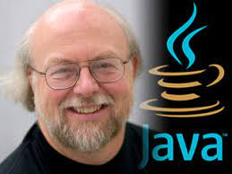

Birth of Java
2

Slide 9
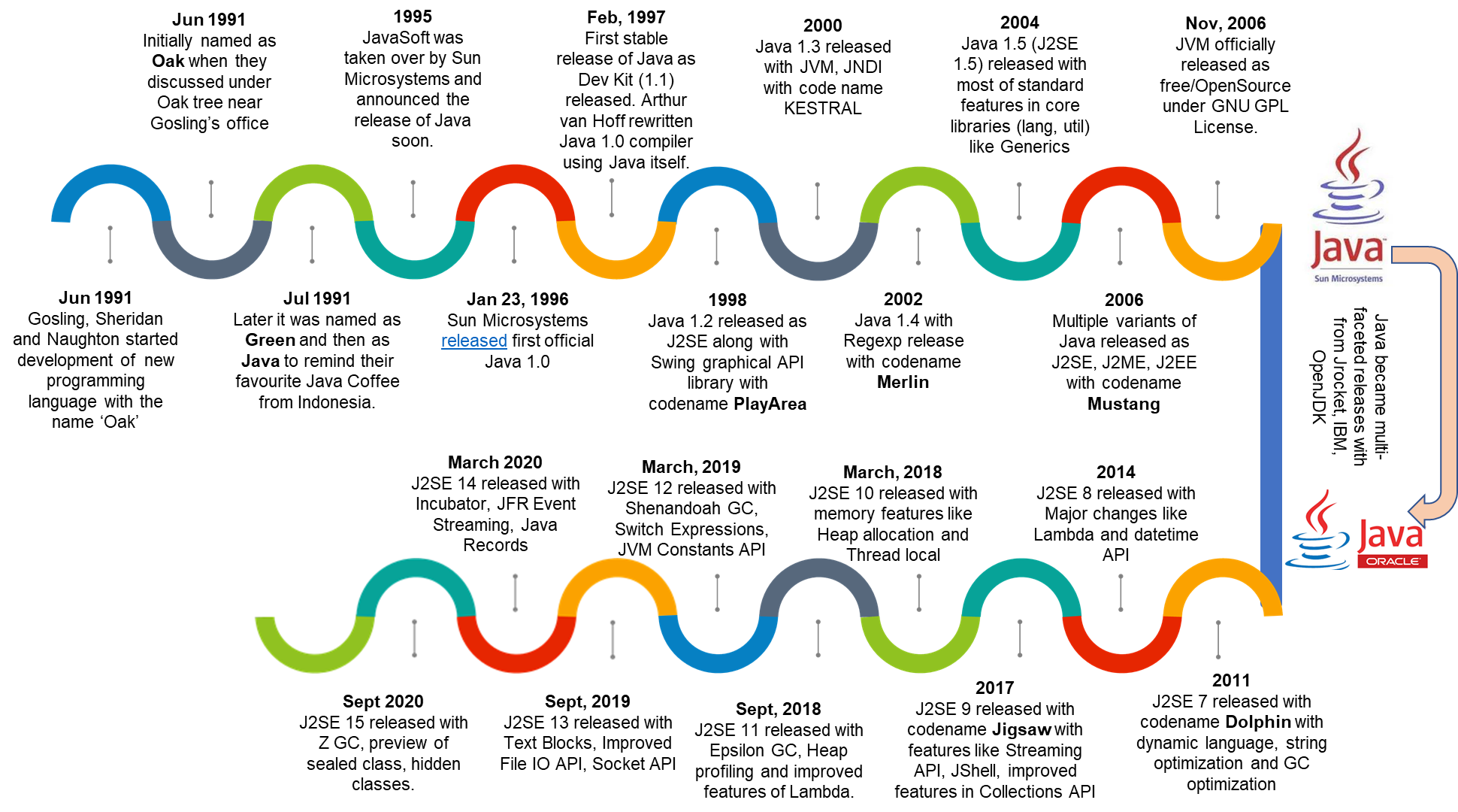

Slide 10
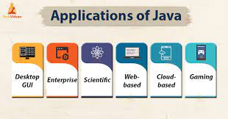
Java Applications

Slide 11
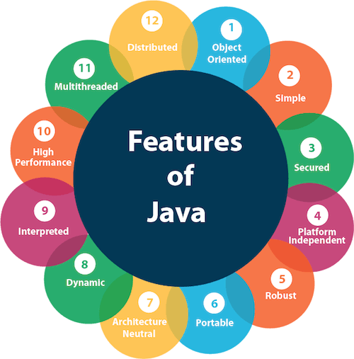
Features of Java

Slide 12
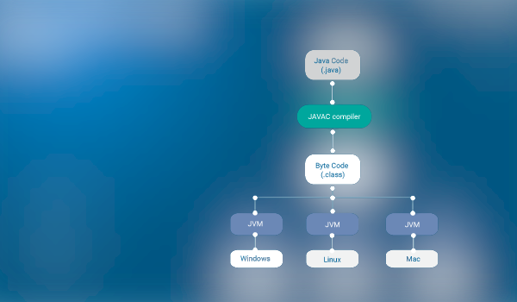
Java as Machine Independent Language

Slide 13
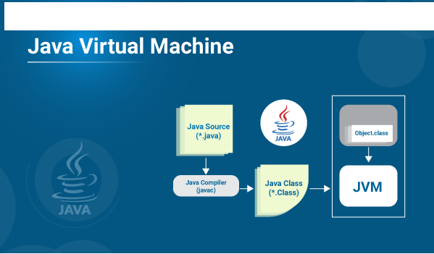
Java Virtual Machine – How It works

Slide 14
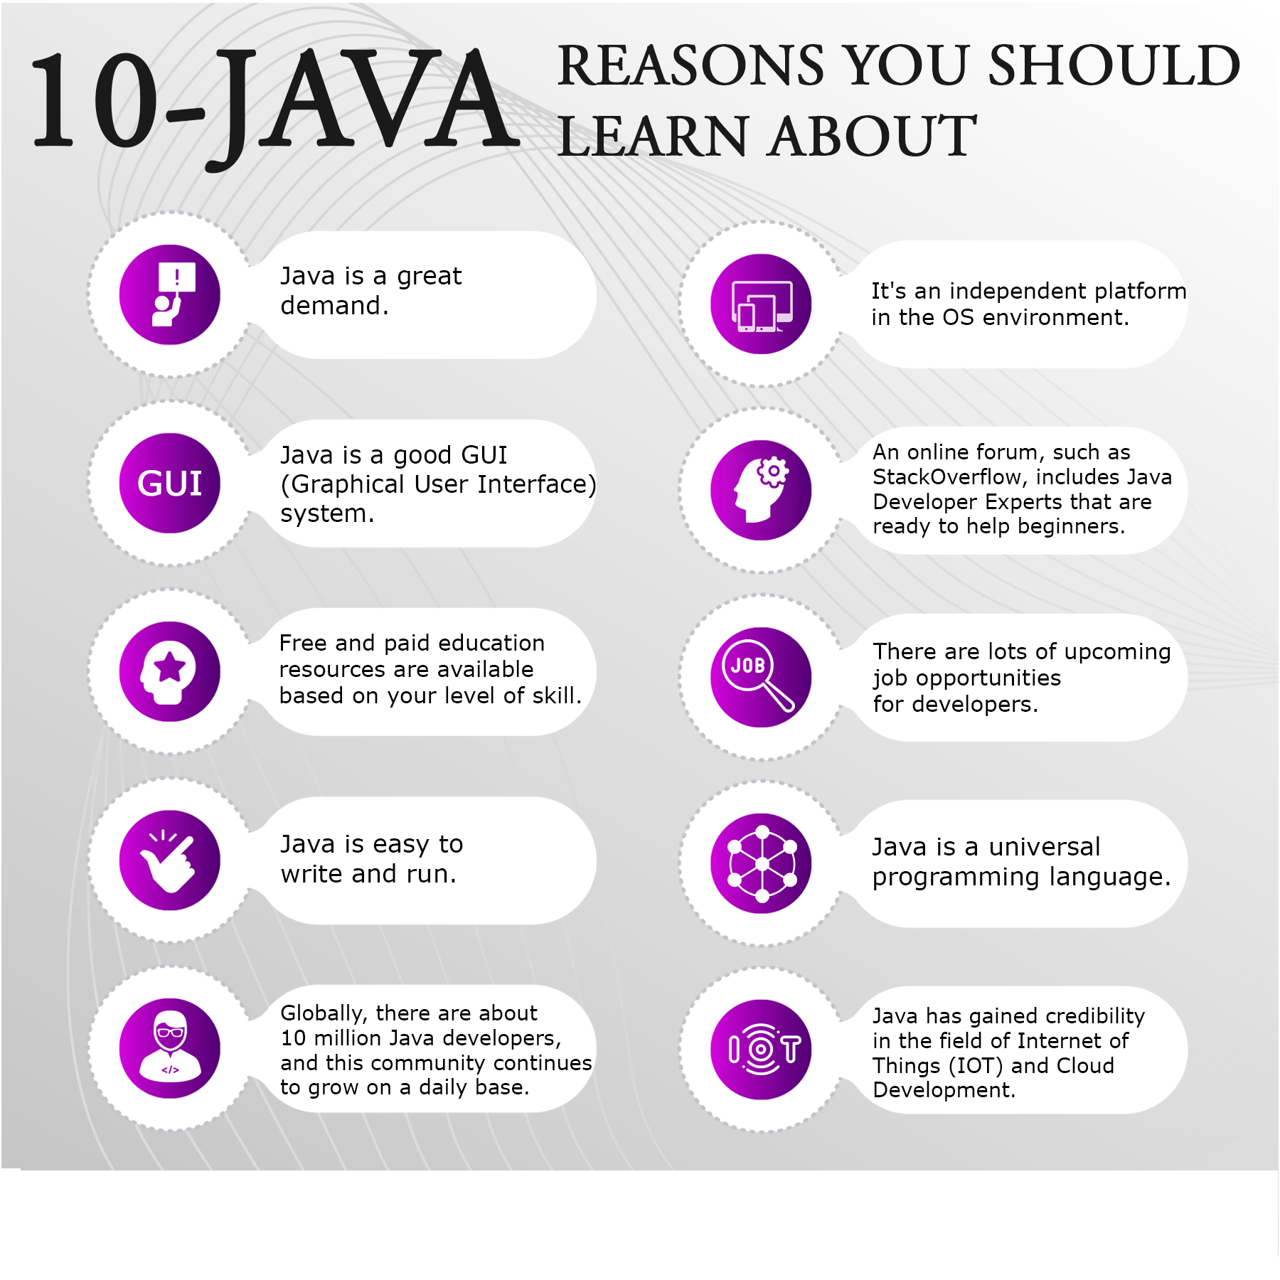

Slide 15
Thank You

